Slide 1
RAMACHANDRAN PLOT
SELMA ABDUL SAMAD
BCH-10-05-02
S1-MSc.BIOCHEMISTRY

Slide 2
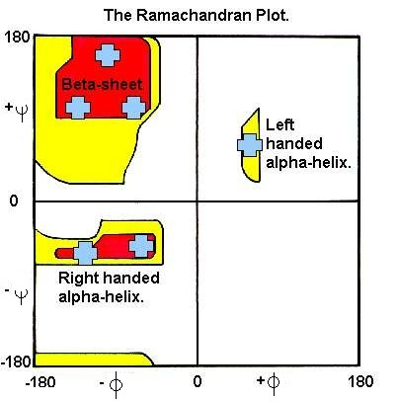
RAMACHANDRAN PLOT INDICATES THE ALLOWED CONFORMATIONS FOR POLYPEPTIDES
IT IS NAMED SO AFTER ITS INVENTOR GOPALASAMUDRAM NARAYANA RAMACHANDRAN

Slide 3
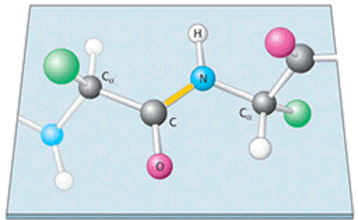
A PEPTIDE BOND
PEPTIDE BOND
Polypeptides are polymers of amino acid residues linked by peptide group
Peptide group is planar in nature which limits the conformational flexibility of polypeptide chain

Slide 4
A peptide group always exist is trans conformation
Cis form is less stable due to steric hindrance
EXCEPTION : Cis configuration is seen in peptide bonds to approximately 10% of Proline residues as in that case the steric interference is reduced

Slide 5
Structure of peptide group was analysed by Linus Pauling and Robert Corey in 1930 s.
They performed x-ray diffraction studies of crystals of amino acids and simple di and tri peptides.
Study showed that
O=C—N peptide bond is shorter than O=C—N bond in simple amines
Atoms associated with peptide bonds are coplanar
A small electric dipole is formed by resonance or partial sharing of two pairs of electrons between the carbonyl oxygen and amide nitrogen
The six atoms of peptide group lie in a single plane with O of C=O and H of NH being trans to each other

Slide 6
So they concluded that
The peptide (O=C—N) bonds are unable to rotate freely due to their partial double bond character (approx. 40%)
Rotation is permitted only about Ca—N and O=C—Ca (torsion angles)
These conclusions are supported by
O=C—N bond is shorter than N—Ca bond by 0.13 A
C=O bond is longer by 0.02 A than in aldehydes and ketones

Slide 7
TORSION ANGLES

Slide 8
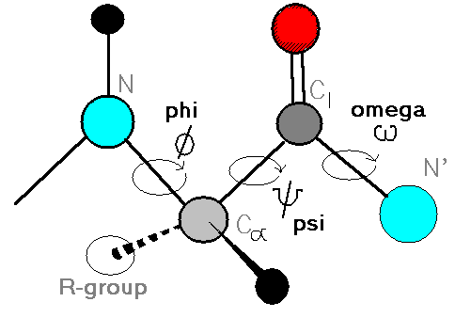
The backbone or main chain of a polypeptide involves the atoms in peptide bond
ie., a linked sequence of rigid planar peptide groups with consecutive planes sharing a common point of rotation at Ca
The conformation of this backbone is described by torsion angles / dihedral angles / rotational angles around Ca –N ( ) bond and Ca --C ( ) bond of each residue

Slide 9
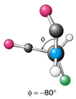
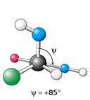
The angles and are both 180 when the polypeptide chain is in tis fully extended conformation and all peptide groups are in same plane
In principle, both these angles can have any values between +180 and -180 , but many values are sterically constrained.
ie., rotation around and bonds forming certain and combinations cause collisions. They are the sterically forbidden values that bring atoms closer than their corresponding van der waal’s distance.
The Ramachandran plot shows the sterically allowed values of and angles.
Ca—N
C—Ca

Slide 10
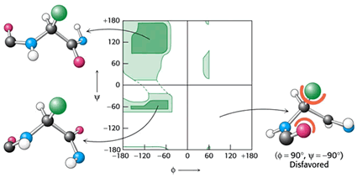

Slide 11
In the Ramachandran plot,
Most areas are forbidden
Only 3 small regions are physically accessible to most residues
Still there are some exceptions
Proline has cyclic side chain ; rotation around bond is constrained by its inclusion in the pyrrolidine ring ; values to angles around -60 ; Proline is the most conformationally restricted amino acid residue
Glycine – has no B carbon atom – so least sterically hindered than other amino acids – its permissible range covers a large area of the plot(even outside shaded regions )
At glycine residues polypeptide chain often assumes conformations that are forbidden to other residues. So glycine frequently occurs in turn regions of proteins where any other residue would be sterically hindered.
Ca—N

Slide 12
The most important difference between theoretically proposed Ramachandran plot and observed Ramachandran plot is in region around 0 and -90
As per modelling studies , this region is not permitted
But there are many residues with these angles.
ie., steric clashes are prevented in these regions by allowing minor distortions
of peptide bond.

Slide 13
RAMACHANDRAN PLOT FOR ALPHA HELICES AND BETA STRANDS

Slide 14
IN ALPHA HELIX,
The and values of each residue are similar
They cluster around a stable region of the Ramachandran plot , centered at a
of -57 to -60 and a of -47 to -50 degrees .
This similarity gives alpha helix , a regular repeating structure.
Also , the intramolecular H bonds between residues n and n+4 in alpha helices tend to ‘lock in’ rotation around the and bonds , restricting the
and angles to a relatively narrow range.
ie., In alpha helix,
is -40 to -100 degrees
is -40 to -65 degrees
Ca—N
C—Ca

Slide 15
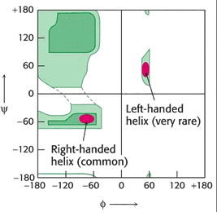
RAMACHANDRAN PLOT FOR ALPHA HELICES

Slide 16
IN BETA SHEETS,
The tortion angles have a broad range of values, occupying a large stable region in the upper left hand corner of the Ramachandran plot.
Typical angles for residues in parallel and antiparallel strands are not identical
Since most beta strands are twisted, they possess broader range of and values than regular alpha helix
In beta strands ,
is -80 to -120 degrees
is -120 to -170 degrees

Slide 17
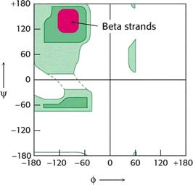
RAMACHANDRAN PLOT FOR BETA STRANDS

Slide 18
IN LOOPS AND TURNS,
The values of both torsion angles are usually well within the permitted regions of the ramachandran plot and often close to the values of residues that form alpha helices or beta strands.

Slide 19
THANK YOU

